Slide 1
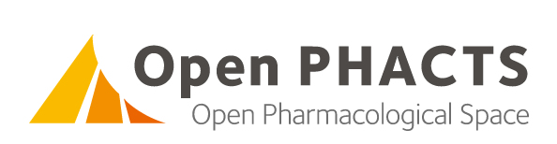
Antonis Loizou
(some slides created by Paul Groth)
VU University Amsterdam
LDBC TUC Meeting
Notes:
Openphacts is an imi project with an mou with ehr4cr

Slide 2




























Consortium

Slide 3























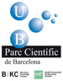



Associate Partners

Slide 4



The Problem
We are all doing this many times……
Pfizer
AZ
GSK
Merck
n

Slide 5


“What is the selectivity profile of known p38 inhibitors?”
“Let me compare MW, logP and PSA for known oxidoreductase inhibitors”
“Find me compounds that inhibit targets in NFkB pathway assayed in only functional assays with a potency <1 μM”
ChEMBL
DrugBank
Gene Ontology
Wikipathways
GeneGo
ChEBI
UniProt
UMLS
GVKBio
ConceptWiki
ChemSpider
TrialTrove
TR Integrity
Notes:
40 prioritized business questions by pharma
- Top priority business question – 5 people 6 hours

Slide 6
Research Questions
Number | sum | Nr of 1 | Question
15 | 12 | 9 | All oxido,reductase inhibitors active <100nM in both human and mouse
18 | 14 | 8 | Given compound X, what is its predicted secondary pharmacology? What are the on and off,target safety concerns for a compound? What is the evidence and how reliable is that evidence (journal impact factor, KOL) for findings associated with a compound?
24 | 13 | 8 | Given a target find me all actives against that target. Find/predict polypharmacology of actives. Determine ADMET profile of actives.
32 | 13 | 8 | For a given interaction profile, give me compounds similar to it.
37 | 13 | 8 | The current Factor Xa lead series is characterised by substructure X. Retrieve all bioactivity data in serine protease assays for molecules that contain substructure X.
38 | 13 | 8 | Retrieve all experimental and clinical data for a given list of compounds defined by their chemical structure (with options to match stereochemistry or not).
41 | 13 | 8 | A project is considering Protein Kinase C Alpha (PRKCA) as a target. What are all the compounds known to modulate the target directly? What are the compounds that may modulate the target directly? i.e. return all cmpds active in assays where the resolution is at least at the level of the target family (i.e. PKC) both from structured assay databases and the literature.
44 | 13 | 8 | Give me all active compounds on a given target with the relevant assay data
46 | 13 | 8 | Give me the compound(s) which hit most specifically the multiple targets in a given pathway (disease)
59 | 14 | 8 | Identify all known protein-protein interaction inhibitors

Slide 7
Semantic Resources – Data sets
814,535,923 triples, 569 predicates
Notes:
Listed triples 479,440,497
Reported triples are larger because of additional data from wikipathways.org
49 GB on disk
~20 GB RAM
25 GB RAM / billion triples

Slide 8
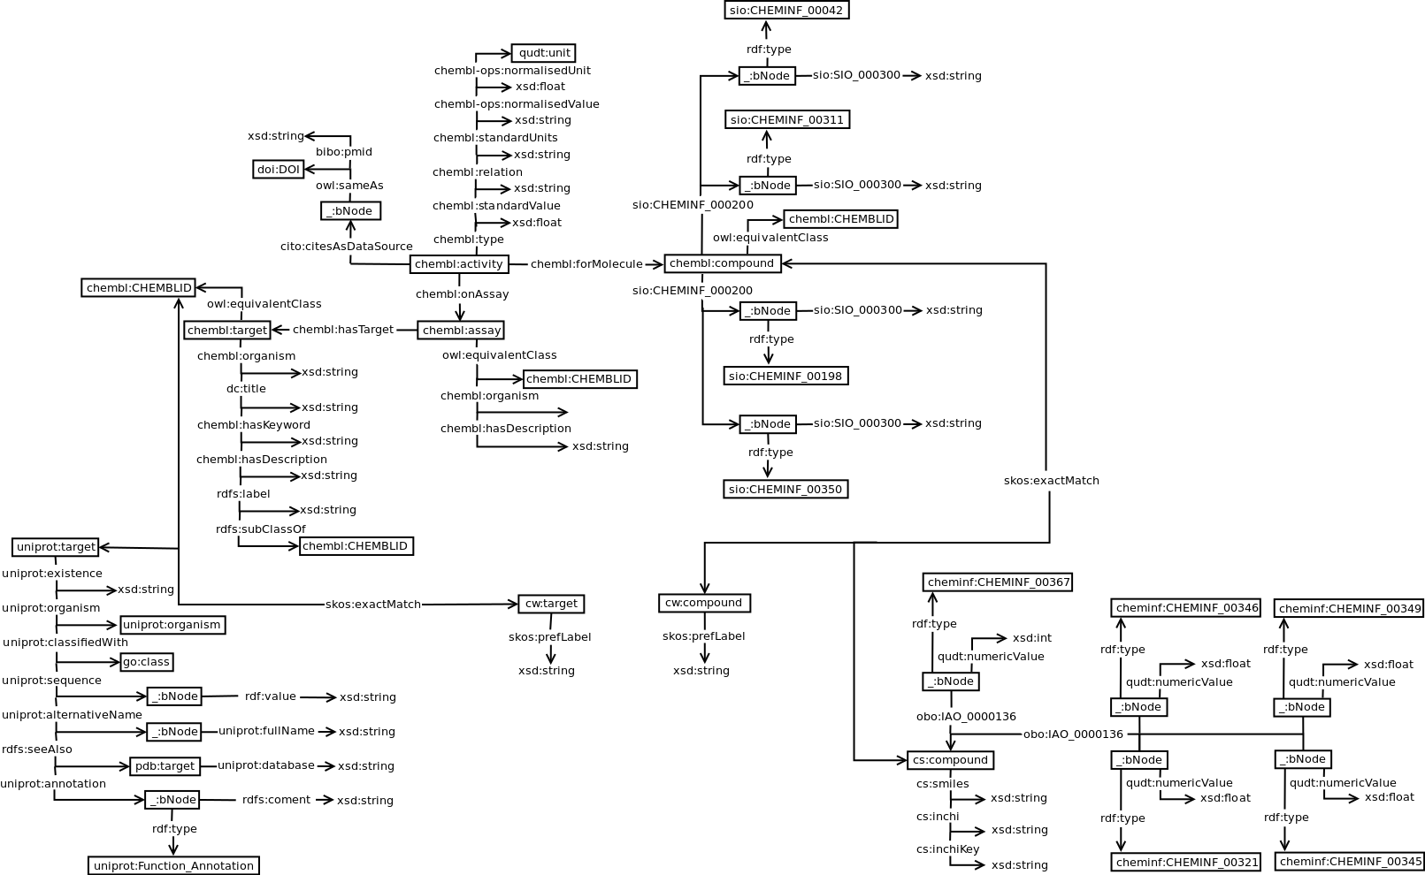
Semantic Resources – Data sets
Notes:
Listed triples 479,440,497
Reported triples are larger because of additional data from wikipathways.org
49 GB on disk
~20 GB RAM
25 GB RAM / billion triples

Slide 9
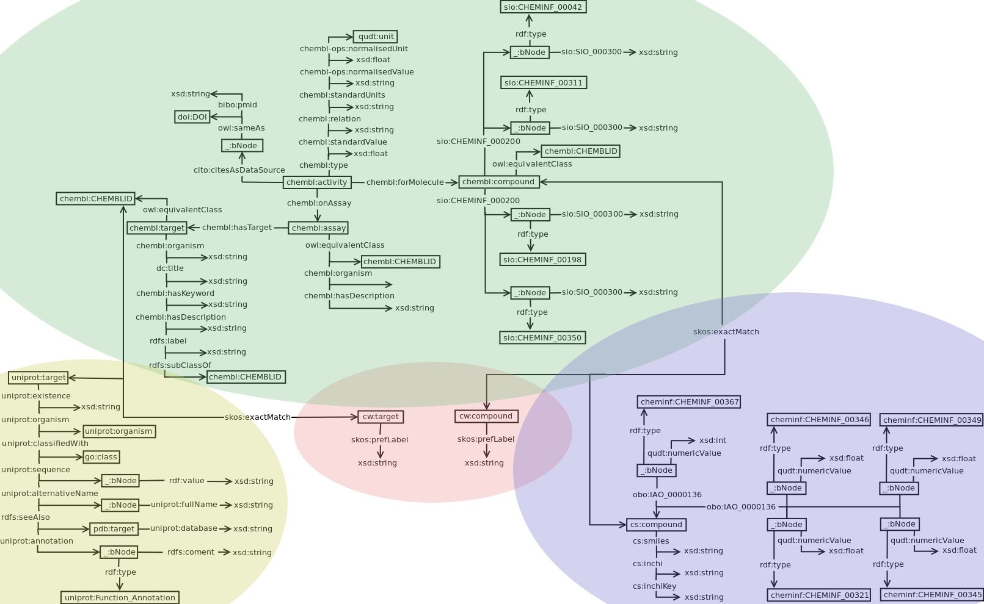
Semantic Resources – Data sets
Notes:
Listed triples 479,440,497
Reported triples are larger because of additional data from wikipathways.org
49 GB on disk
~20 GB RAM
25 GB RAM / billion triples

Slide 10
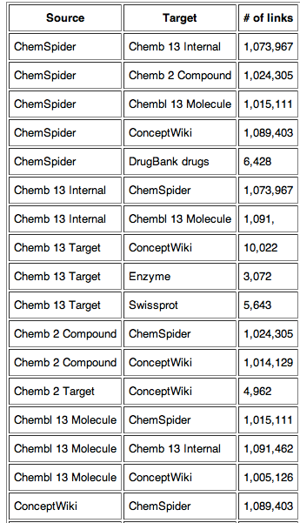
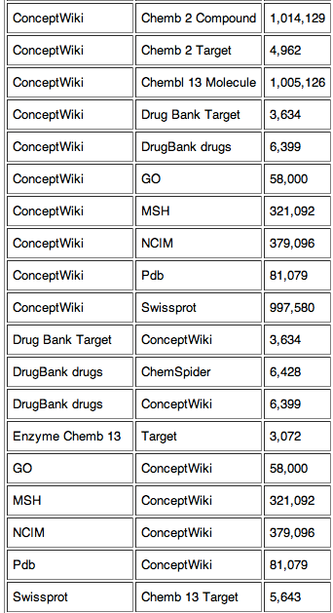
Semantic Resources - Mappings
18 Million
Mappings

Slide 11
Semantic resources - Summary
Types of semantic resources
RDF Datasets
Mappings
Vocabularies
Mesh, UMLS, NCIM
Hierarchies are essential
e.g. ChEBI, Enzyme classification
rdfs:subClassOf reasoning is essential
Notes:
But complex reasoning has not been essential – basic semweb reasoning goes along way

Slide 12
Data Integration
Global – as – View
Flexible global schema defined by domain experts.
Simple, as flat as possible, result structures.
Load data into RDF store
A named graph for each dataset.
Inferred triples computed offline and asserted directly.

Slide 13
Data Integration
Define use cases and view templates
View templates: Required and optional information
Domain experts trust some datasets over others for specific properties.
Results without a core set of properties are meaningless. The rest are optional.
Integration in OpenPHACTS amounts to collating trusted information from the available sources.
Convert view templates to SPARQL queries
CONSTRUCT for projection onto global view
Preserve provenance through void:inDataset

Slide 14
Linked Data API
No public SPARQL endpoint is available for OpenPHACTS
Writing good SPARQL queries has a steep learning curve
Queries that are not well formed can cause instability.
Instead SPARQL queries are embedded into Linked Data API (LDA) endpoints.
Enables API developers to fine tune query performance.
RESTful
Multiple formats (JSON, Turtle, TSV, XML and more)
Pagination
HTTP parameters are mapped to RDF properties and SPARQL variables
Ability to specify elaborate filtering and sorting conditions
Two-level caching of URLs served
Raw RDF results and formatted w.r.t. the “_format” parameter

Slide 15
Linked Data API
First public release today!
http://dev.openphacts.org
http://explorer.openphacts.org
LDA: http://code.google.com/p/linked-data-api/
PHP Implementation (Puelia): http://code.google.com/p/puelia-php/
OpenPHACTS Extension: https://github.com/openphacts/OPS_LinkedDataApi

Slide 16
Identity Mapping Service (IMS)
Instance level mappings are held externally to the RDF store
Driven by Uni. Manchester
http://openphacts.cs.man.ac.uk:9090/OPS-IMS/
Injected into queries at run-time.
Better performance (when co-located).
Provision of flexible mappings: Scientific lenses.

Slide 17
Identity Resolution Service (IRS)
text – to – URI functionality
Driven by ConceptWiki
http://ops.conceptwiki.org/web-ws/
Manually curated
(sub)String search is performed externally to the RDF store.

Slide 18
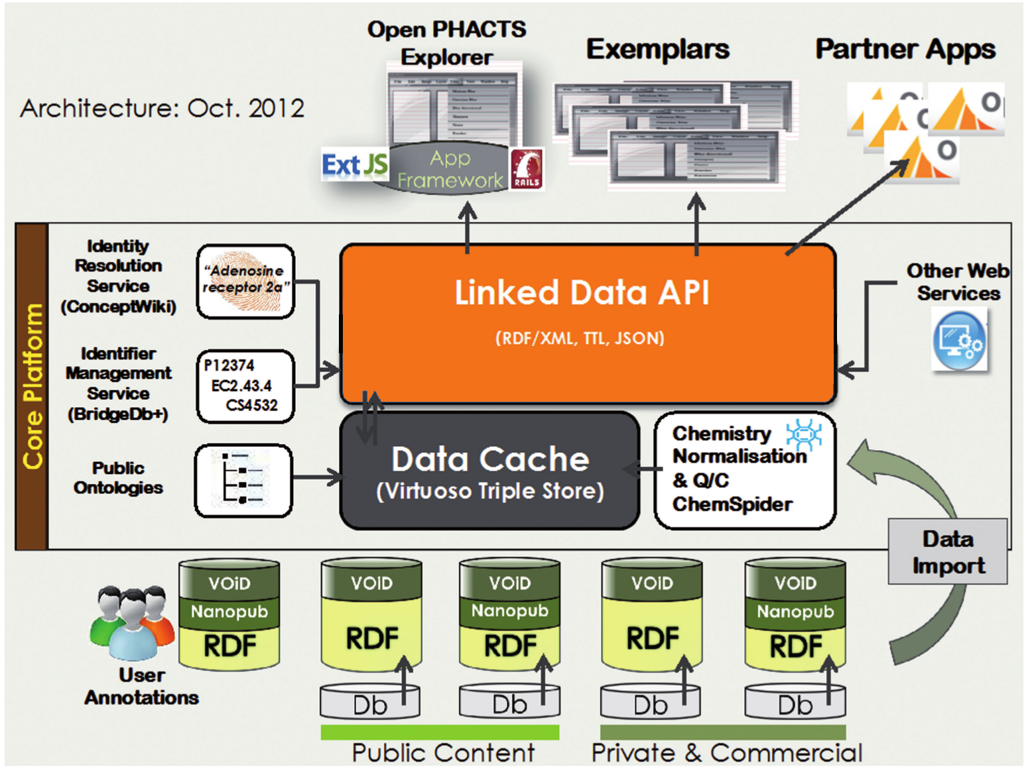
OpenPHACTS architecture

Slide 19
Optimising SPARQL query performance
Syntactic variations of the same query vary wildly in evaluation cost.
Pérez Jorge, Marcelo Arenas, and Claudio Gutierrez. Semantics and complexity of SPARQL. ACM Transactions on Database Systems (TODS) 34, no. 3 (2009): 16.
Evaluated the utility of 5 heuristics:
Minimise OPTIONAL patterns
Use named GRAPHs to localise patterns
Replace connected triple patterns with sequence paths
Use aggregates to reduce the effects of cartesian products.
Compare the performance of different syntax for specifying alternative URIs
Antonis Loizou and Paul Groth, On the Formulation of Performant SPARQL Queries. Preprint: http://arxiv.org/abs/1304.0567

Slide 20
1&2: Compound Pharmacology

Slide 21
1&2: Compound Information

Slide 22
1&2: Target Pharmacology

Slide 23
1&2: Target Information

Slide 24
3: Sequence paths

Slide 25
5: Specifying 10 alternative URIs

Slide 26
5: Specifying 20 alternative URIs

Slide 27
5: Specifying 50 alternative URIs

Slide 28
Performance overview:
Method | # of results | Time (s)
Compound Pharmacology | 1 259 | 1.732
 | 95 | 1.578
Compound Information | 1 | 1.885
Compound Count Datapoints | 1 | 1.803
Target Pharmacology | 1 072 | 11.093
 | 20 | 1.127
Target Information | 1 | 34.759 [1.56 , 242.079]
Target Count Datapoints | 1 | 1.464
Enzyme Class Pharmacology | 586 107 | 350.343
ChEBI Class Pharmacology | 300 724 | 371.526
Notes:
Very keen on further collaboration

Slide 29
Lessons learnt:
Invest in hardware - Develop environment
400GB RAM, 1.5TB SSD, 16 Cores @ 1.8GHz.
Not all RDF stores are created equal
Not all RDF datasets are created equal
Not all SPARQL queries are created equal.
Perfomance is a function of:
SPARQL syntax
Dataset schema
Data size
Loading strategy/named GRAPHs
RDF store
Notes:
Very keen on further collaboration

Slide 30
Open PHACTS Information
http://www.openphacts.org
@Open_PHACTS
Publications
Overview paper: Williams, A.J., Harland, L., Groth, P., Pettifer, S., Chichester, C., Willighagen, E.L., Evelo, C.T., Blomberg, N., Ecker, G., Goble, C., Mons, B.: Open PHACTS: Semantic interoperability for drug discovery. Drug Discovery Today. 17, 1188–1198 (2012).
Technical approach: Gray, A.J.G., Groth, P., Loizou, A., et al.: Applying linked data approaches to pharmacology: Architectural decisions and implementation. Semantic Web. (2012).
SPARQL heuristics: Antonis Loizou and Paul Groth, On the Formulation of Performant SPARQL Queries. Preprint: http://arxiv.org/abs/1304.0567
Notes:
Very keen on further collaboration

